Slide 1
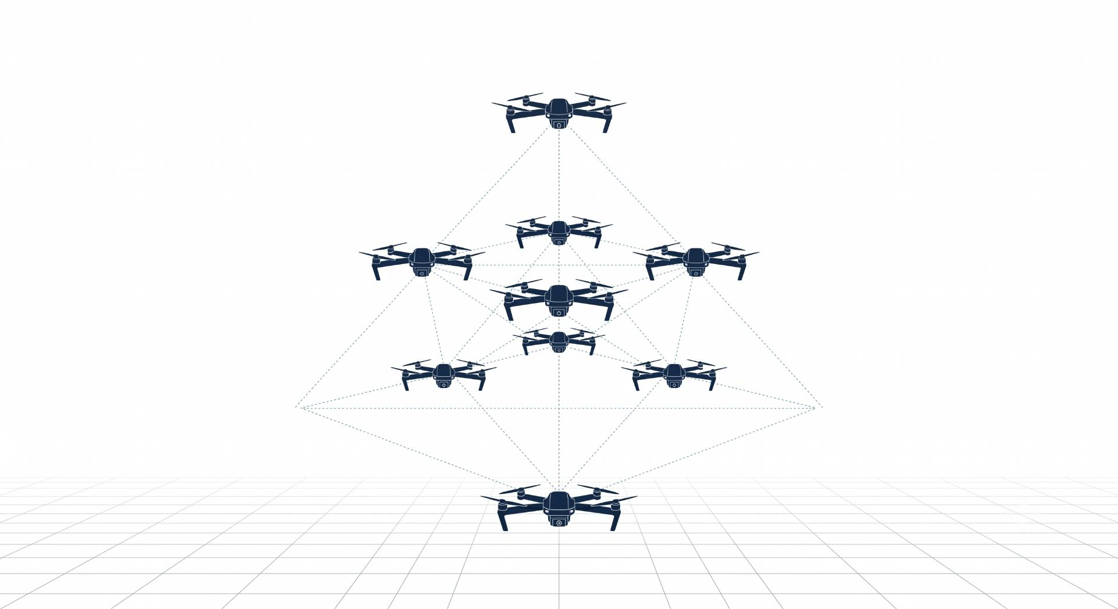

MAPPO Framework for Joint Dynamic Target Assignment and Conflict-Aware Collision Avoidance in Multi-UAV Systems
Ayesha Khalil, CIIT/SP25-RCS-009/ATD
Supervisor: Dr. Faisal Rehman Co-supervisor: Dr. Ehzaz Mustafa

Slide 2
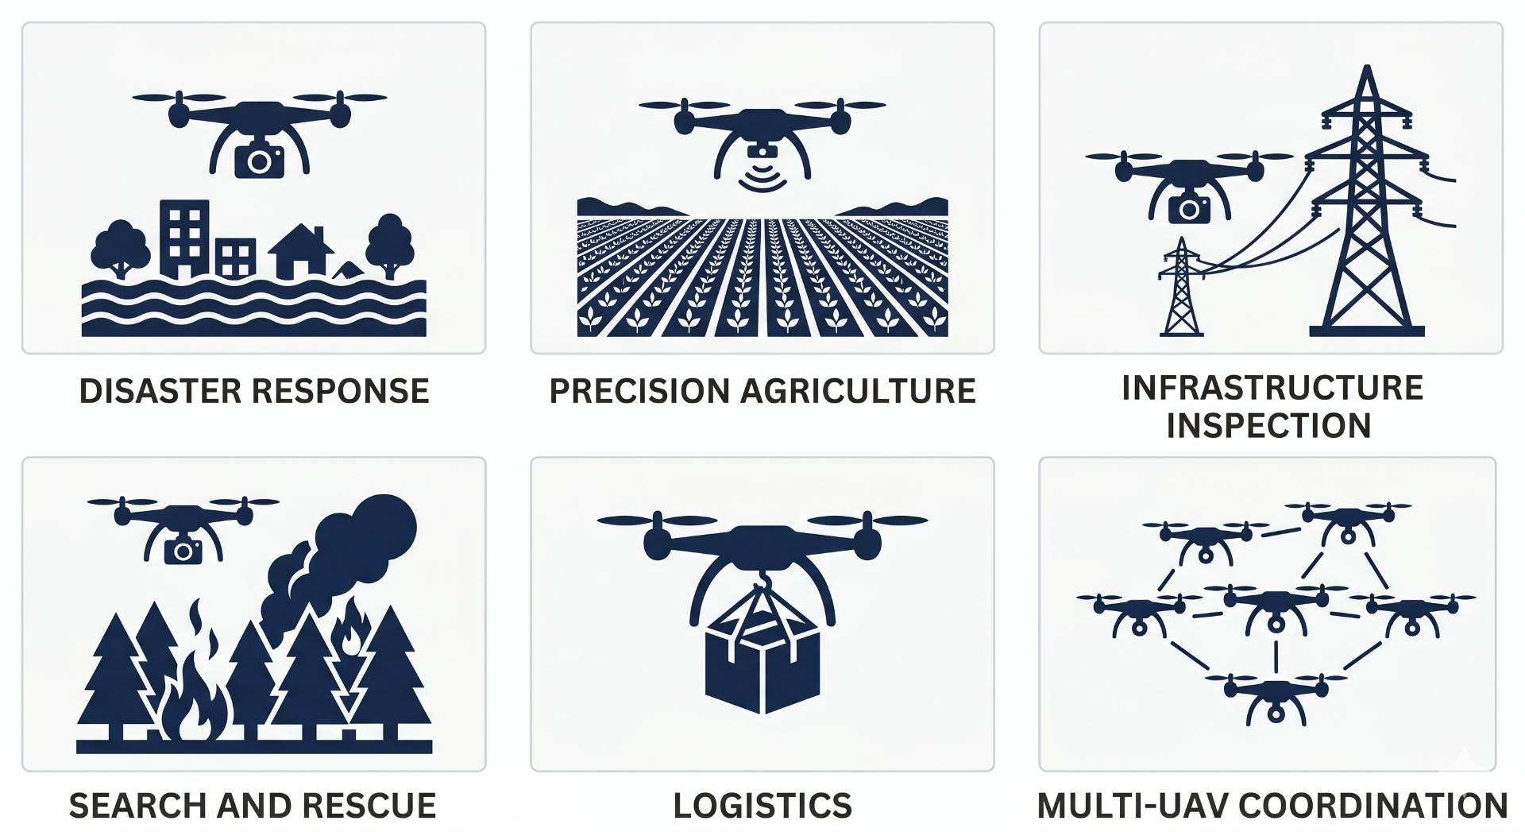
Introduction: Why UAVs?
From military tools to critical civilian infrastructure
UAVs are frequently used in disaster response, agriculture and inspection.
Single drone cannot cover complex and large-scale missions.
Teams of drones are faster, redundant and more effective.
Hardware is ready, coordination is the unsolved problem.

Slide 3
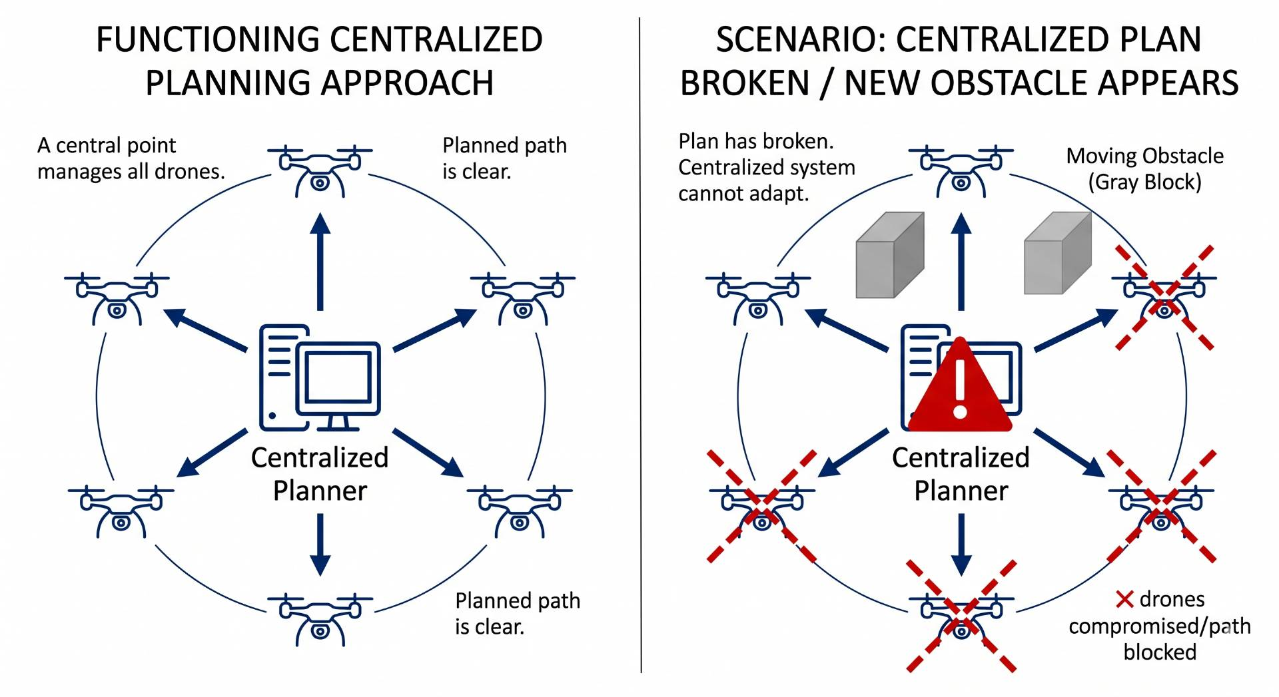
Introduction: Multi-UAV Coordination
Multiple drones, shared airspace, conflicting decisions
Classical planners compute one global solution too slow.
Dynamic environments break pre-planned paths instantly.
Drones need to adapt in real-time, independently.
Solution: let drones learn coordination through experience.

Slide 4
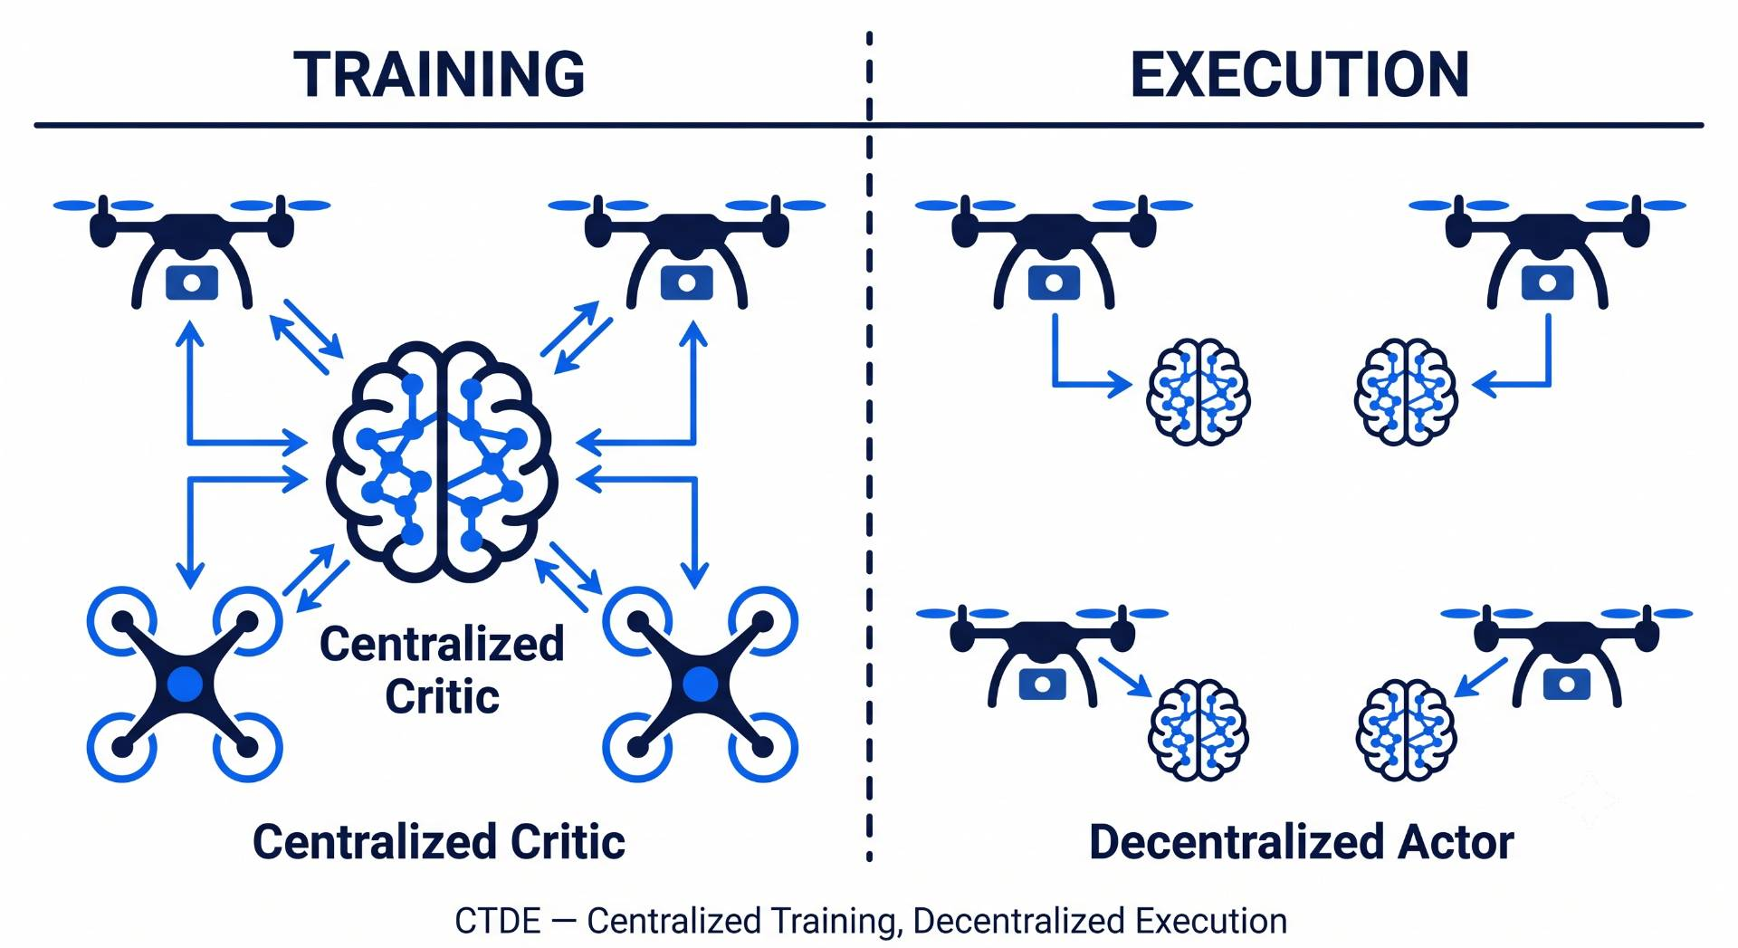
Introduction: DRL & MARL
Learning-based coordination how it works
DRL: agent receives reward, learns optimal policy.
MARL: extends DRL to teams of cooperating agents.
CTDE Architecture: train with shared info, execute independently.
MAPPO (Multi-Agent PPO): best-performing cooperative MARL algorithm.

Slide 5
Motivation:
Two halves of the same problem
Drones must reach targets AND avoid collisions, neither is optional.
Too much safety means mission abandoned. Too much urgency means crash.
Right balance changes every timestep depends on situation.
One wrong trade off cascades through the entire swarm.
No existing framework learns this balance all use fixed rules.

Slide 6
Related Work:
Authors | Contribution | Methodology | Dataset/Sample | Strength | Limitation
Govinda, Brik & Harous (2025) | Systematic review of DRL for UAV, robotics, transportation | Literature survey across published DRL studies | Published papers (no primary data) | Identifies lack of unified frameworks as the key open gap | Survey only no new algorithm proposed
Tang, Liang & Li (2024) | Single UAV navigation in dynamic obstacle environments | Improved D3QN + Prioritized Experience Replay + heuristic action bias | Custom 2D sim, single UAV, moving obstacles | 95% success rate, outperforms A* and RRT | Single drone only, discrete actions
Kong, Zhou, Li & Wang (2024) | Joint target assignment + path planning for multi-UAV | TANet-TD3 + Hungarian algorithm supervision + POMDP | Custom 2D sim, 5 UAVs, moving targets | First paper combining assignment + path planning | no inter-drone collision avoidance
Jarray, Zaghbani & Bouallègue (2025) | UAV path planning in large-scale 3D environments | DQN + 3D CNN + dynamic reward formula | Custom 3D sim, 25 km² area, 4 obstacle densities | 98% success in 3D, beats PSO and GWO | Single drone, static obstacles only

Slide 7
Related Work Cont…
Authors | Contribution | Methodology | Dataset/Sample | Strength | Limitation
Rezaee et al. (2026) — IGAT-MARL | Collision avoidance using sparse conflict-aware interaction graph | Conflict-driven sparse graph + Improved GAT + curriculum | BlueSky sim, 3–10 fixed-wing UAVs, conflict-guaranteed episodes | 44% fewer edges, 17% higher reward, 10% fewer dangerous events | No target assignment — drones have no goals
Sheng et al. (2026) — DA-MAPPO | Real-time dynamic target assignment embedded in drone observation | Hungarian algorithm at every step + MAPPO + 4-tier reward + curriculum | Custom sim, 3 UAVs, 3 dynamic targets, 30–50 static obstacles | 90–99% mission success, robust to 50% packet loss and 6-step delay | 3 drones only, no inter-drone collision avoidance
Zhang et al. (2025) | Large-scale UAV swarm navigation with mean-field RL | Mean-field DDPG + multi-head attention + CTDE | Custom 2D sim, 20–120 UAVs, static obstacles | >90% success at 120 drones where baselines collapse | static obstacles, homogeneous drones
Xu et al. (2026) — MRLMN | UAV multi-hop networking with LLM-guided MARL | GPT-4o knowledge distillation + IPPO + role-based reward decomposition | Custom sim, 12–24 UAVs, 150 ground users | 52% higher data rate, 27% more user coverage | GPT-4o dependency, no energy modeling

Slide 8
Gap in existing work:
Assignment and avoidance always studied in isolation.
No single learned policy handles both simultaneously.
All frameworks use fixed coefficients set before training.
Assignment weight and avoidance weight never change mid-mission.
No mechanism exists to learn priority this is the gap.

Slide 9
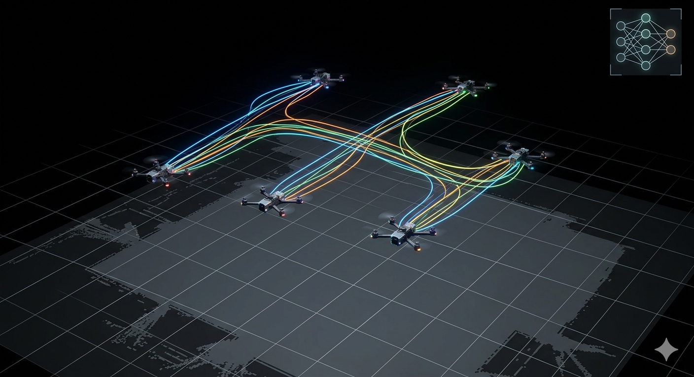
Problem Statement:
In multi-UAV missions, task allocation and collision avoidance are inherently interdependent, as assignment decisions influence trajectories and avoidance maneuvers can invalidate assigned tasks. This coupling can lead to uncovered targets, reassignment conflicts and new collision risks .

Slide 10
Research Objective
Design a learned mechanism to balance assignment and avoidance jointly.
Test scalability across 3, 5, and 8 drones.
Compare learned α against fixed reward weights.
Find where and how the framework fails.

Slide 11
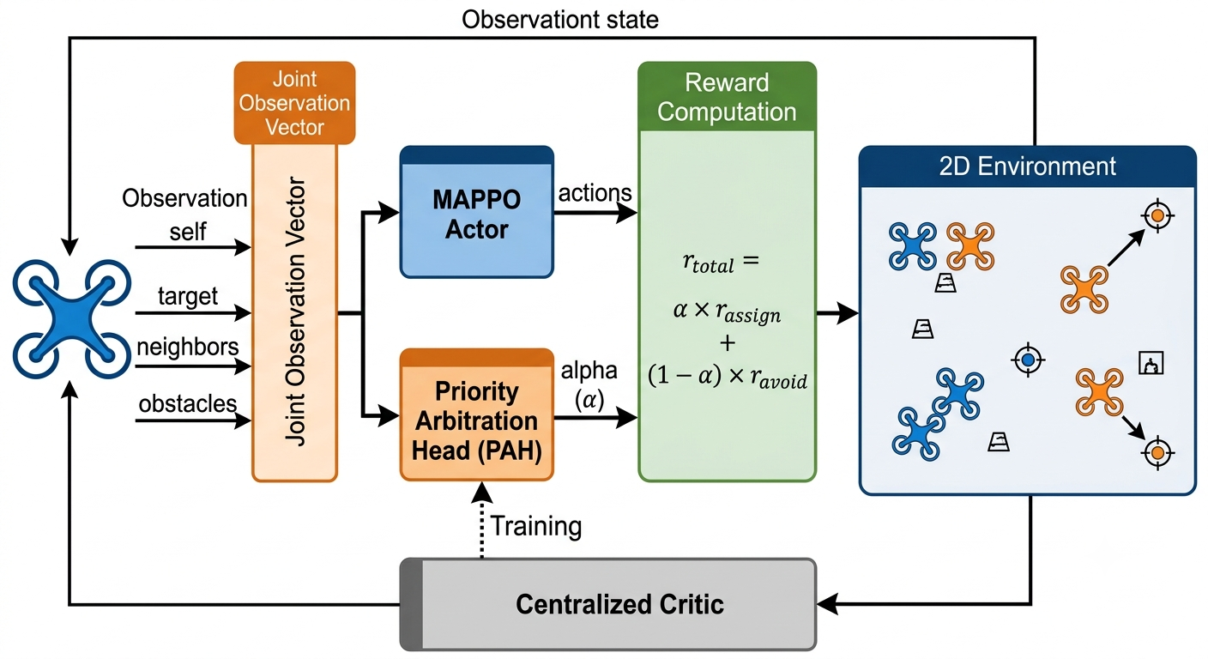
Proposed Methodology:
.

Slide 12
References:
S. Govinda, B. Brik, and S. Harous, "A survey on deep reinforcement learning applications in autonomous systems," IEEE Trans. Intell. Transp. Syst., vol. 26, no. 7, 2025.
J. Tang, Y. Liang, and K. Li, "Dynamic scene path planning of UAVs based on deep reinforcement learning," Drones, vol. 8, no. 2, p. 60, 2024.
X. Kong, Y. Zhou, Z. Li, and S. Wang, "Multi-UAV simultaneous target assignment and path planning based on deep reinforcement learning in dynamic multiple obstacles environments," Front.Neurorobot., vol. 17, p. 1302898, 2024.
R. Jarray, I. Zaghbani, and S. Bouallègue, "Dynamic reward-based deep reinforcement learning algorithm for UAV path planning in large-scale environments," Procedia Comput. Sci., vol.270, pp. 692–702, 2025.
M. R. Rezaee, N. A. W. A. Hamid, M. Hussin, and Z. A. Zukarnain, "Efficient multi-agent deep reinforcement learning algorithm for multi-UAV collision avoidance," Appl. Soft Comput., vol.197, p. 115145, 2026.
Y. Sheng, X. Xie, H. Liu, and J. Li, "Dynamic target assignment and cooperative decision-making for UAV swarms based on multi-agent reinforcement learning," IEEE Internet Things J., doi:10.1109/JIOT.2026.3686066, 2026.
Y. Zhang et al., "Large-scale UAV swarm path planning based on mean-field reinforcement learning," Chin. J. Aeronaut., vol. 38, no. 9, p. 103484, 2025.
Y. Xu et al., "Scalable UAV multi-hop networking via multi-agent reinforcement learning with large language models," arXiv:2505.08448, 2026.

Slide 13
Thank you!

